Slide 1




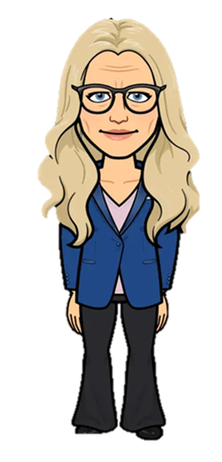


WITHAM OAKS ACADEMY
NEWSLETTER
adminwoa@inspiresmat.co.uk www.withamoaksacademy.co.uk
ISSUE 12
w/c: 20th April 2026
Dear Parents and Carers,
Welcome back!
This week, we have have been spending time in the classrooms with the children, admiring their work and watching their enjoyment while they are learning.
We have also been having a wonderful time in the sunshine at Witham Oaks since the Easter break. The children have been making the most of the dry weather in the outdoor learning area, where they have been busy with team building activities and this week, 4E have been toasting marshmallows on the fire. Thank you to the amazing helpers who supported this event. We have opened the school field at lunchtime which is always a popular decision with the children, and we look forward to sharing many more outdoor experiences with them as we move through the term. As we are now into the Summer term, we are allowing the children to remove their ties, particularly in the warmer weather. Summer dresses are also permitted. Please remember, PE kits and trainers should be logo free. We do have items that can be purchased from the school and we have free pre-loved uniform on the rail in reception. Pop into the office and speak to Miss Owen if we can support you with this.
As you will be aware, following consultation with our school community, we have launched the new vision at Witham Oaks: 'Belong, Experience, Flourish' and that is exactly what we want the children to do while they are with us. We thank you, the children and staff for input into creating the vision.
We would like to remind you that the gate closes at 8:45am in the morning and if the children arrive after this time, they should enter through the school office. This is so we can ensure they have ordered a lunch should they need to do so.
We welcome feedback about the new dishes on the school menu. Perhaps you could ask you children to rate their meals with their favourites as well as what they think could be improved!
We wish you a happy weekend and hope the sun stays shining.
KEY DATES
04/05/26 | BANK HOLIDAY
11/5/26-14/5/26 | Year 6 SATs Week
09/05/26 | 5 Korea Class Lunch
25/05/26-29/05/26 | HALF TERM
01/06/26 | NON-PUPIL DAY
01/06/26-12/06/26 | Year 4 Multiplication Checks
09/06/26 | 5 Singapore Class Lunch
16/06/26 | Year 3 & 4 Sports Day
16/06/26 | 5 Thailand Class Lunch
17/06/26 | Year 5 & 6 Sports Day
Spa Road  Witham  CM8 1NA
Co-Headteachers  Mrs M Harrington, Mr D Sheehan
Telephone  01376 513322

Slide 2
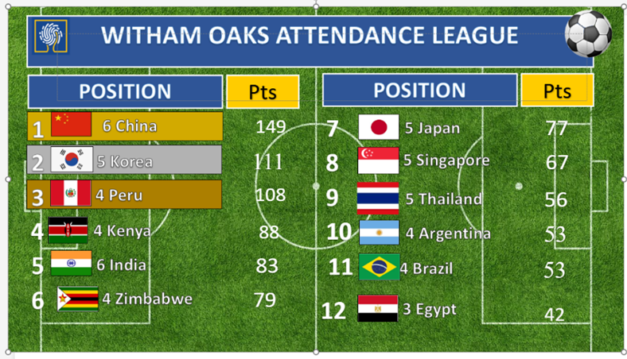

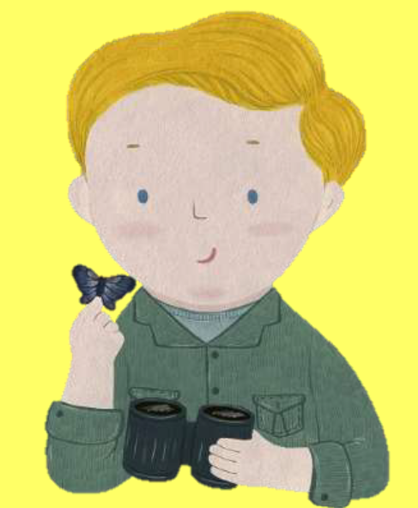







This Week’s Attendance
Attendance Cake
5 Singapore
Attendance Update
Regular attendance is crucial for academic and social success. Missing school can disrupt learning and make it difficult to catch up. Some children are missing out on part of their education by arriving late to school. The gates are open from 8:35am. Please make sure your child arrives before 8.45am when the gates close. We are monitoring punctuality very closely and may contact you if we have a concern.
Attendance League
House Team Competition/Update
5406
5570
5451
4592
RECENT LETTERS- AVAILABLE ON THE WEBSITE
All communication will be sent through ParentMail. Please ensure that you have given us a current email address.
Issues with ParentMail communication should be emailed to
adminwoa@inspiresmat.co.uk

Slide 3









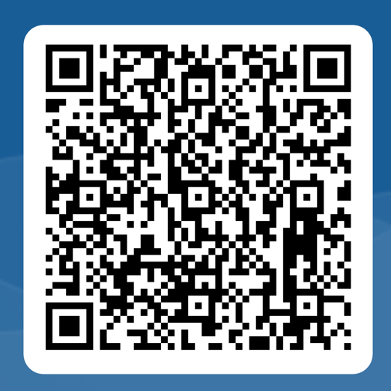
This Week’s Awards
Stars of the Week
Each week, children will be celebrated for demonstrating one or more of the five key character strengths
M
Jason – 3P
Harmony – 5S
Arabella Z – 5T
Theodore V – 4E
Ellie – 4Z
William –4K
Beux-Blue – 5K
Nevaeh-Rae – 3A
Theo – 3B Leo O - 5T
Olivia-Rose – 4E
Kaiden – 4K Freya - 6I
Leo - 4Z
Reggie – 3A
Cobie – 6I
Jamie - 5S
Kit – 3B
Teddy-Lee – 6C
Ben – 3P
Owen – 5K
Malak - 6J
Lealand – 6J
Sports Personality of the Week
Peyton
Week 3
w/b 27/04/2026
Parent/Carer Survey
As part of Essex County Council's Health and Safety policy, all jewellery must be removed for PE, including earrings. Children must not wear earrings or other jewellery during the school day, unless for religious reasons.
Sleeper studs must be removed before PE/Games – they can no longer be covered with tape or plasters.
To help, please ensure earrings are removed before school on PE days.
Thank you for supporting us to keep children safe.
In our bid to both highlight the schools success and continually improve, we would like as many of you as possible to complete the attached survey. These questions are ones which would be provided by Ofsted during an inspection and will inform our school development plan.

Slide 4


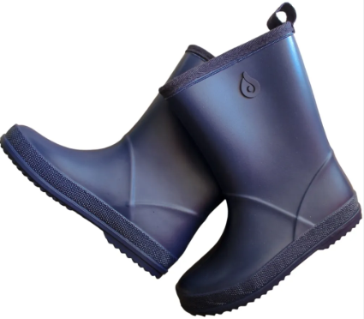
In Other News…
Term Dates:
Please see term dates for the remainder of the school year listed below. Ensure any holidays are booked during the period of times highlighted in red:
Autumn 1 | 2/9/25 | 23/10/25
Autumn Half Term | 27/10/25 | 31/10//25
Autumn 2 | 3/11/25 | 19/12/25
Christmas Holiday | 22/12/26 | 2/1/26
Spring 1 | 6/1/26 | 13/2/26
Spring Half Term | 16/2/26 | 20/2/26
Spring 2 | 23/2/26 | 27/3/26
Easter Holiday | 30/3/26 | 10/4/26
Summer 1 | 13/4/26 | 22/5/26
Summer Half term | 25/5/26 | 29/5/26
Summer 2 | 2/6/25 | 17/7/26
Inset Days
1/9/25 24/10/25 5/1/26 1/6/26
20/7/26
Please may we remind you that we do not authorise any holiday during term time.
Outdoor Learning
Please can we ask for donations of old wellington boots or old pairs of trainers for outdoor learning. These will be kept on site for children to use if needed. We are committed to supporting learning in all weathers, particularly during the wetter months, and having appropriate footwear helps keep children comfortable and safe when outdoors.

Slide 5

In Other News…
Celebration Corner
We love to celebrate the amazing things our students accomplish both in and out of school! Please send us photographs and a brief description of their achievement, so we can feature it in here in our Celebration Corner. It’s a great way to celebrate their hard work and dedication, and to share their success with our school community!
You can email your photos and information to adminwoa@inspiresmat.co.uk
ATTENDANCE AWARDS
ATTENDANCE AWARDS
The following children have been awarded certificates today in recognition of their 100%
attendance and improved at school.
Two Terms of 100 Attendance - Silver Award:
Elaine J, Freya H, David C, Ava G, Owen T, Bobby S, Albie M, Leo E, Bethany T, Nina-Rose M, Maisie M, Sienna B, Anaia M, Kaiden S, Benjamin T, Davida A, Violet J, Olivia M, Millie D, Zack J, Jake M, Hayden T, Leo S, Harry B, Ben M, Jacob S, Jason D, Adrijana D, Aya M, Harper P,
Brooke B, Gracie D, Theo C, Hunter D, Jasmine G, Lillian M, Mya B, Alissia C, Albert M, Violet W, Froukje M.
One Term of 100% Attendance - Bronze Award:
Elsie B, Skye K, Oscar M, George T, Faizah A, Violet M, Oscar W, Liam B, Joseph M, Mason B, James C, Elijah L, Jacob M, Florence S, Oliver S, Reggie V, William D, Alieya J, Ronnie S,
Kuzey S, Tilly C, Jasmine C, Mario J, Peyton P, Elliot S, Rose I, Daniel D, Arabella R, Jamie P, Teddy W, Noah L, Harper-Rose S, Ruby M, Kayden T, Harrison G, Robin H, Alfie S, Dylan B,
Oliver B, Riley M.
Improved Attendance
Elsie B, Daniel Junior C, Tommy G, Dzhemre K, Oscar m, Mileena O, Hallie P, Freya-Louise B, Thea C, Pippa D, Olivia E, Oakley O, Theo R, Billy R, Lille T, Max K, Louie H, Sienna H, Joseph M, Cassius B, Mason B, Elijah L, Freddie R, Ronnie S, Sonny K, Alisa-May K, Alieya J, Florence S, William D, Andrew W, Skyla W, Ellie S, Jamie M, Alphons A, Samuel A, Zackery B, Freddie C, Jasmine C, Kason C, Seth D, Rowan J, Mario J, Peyton P, Beux-Blue W, Noah L, Brooke P,
Danny S, Arthur W, Caia B, Elijah B, Aria B, Dava C, Armanda D, Harmony H, Khodey H, James L, Jamie P, Josh T, Isabelle C, Daniel D, Teddy D, Reggie G, Joseph J, Oliver N, TJ P, Ruby C,
Elliot S, Fatma S, Arabella Z, Owen D, Teddy-Lee G, Freddie H, Rose I, Evie W, Scarlett P,
Ronnie T, Lexi-Mae B, Jasmin B, Chloe C, Cobie E, Ginnel H, Brooke M, Annabelle K, Riley M, Tianna-Mai M, Joshua O, Christopher P, Summer S, Alfie S, Alex W, Harrison G, Robin H, Dylan H, Laeland M, Ruby M, Lily-Rose M, Kayden T.

Slide 6
In Other News…
Spring Dates 2025-26
5/1/26 NON-PUPIL DAY
12/1/26 Year 3 Barleylands Trip
13/1/26 4 Kenya Class Lunch
21/1/26 Young Voices at the O2
5/2/26 6 China Class Lunch
6/2/26 Number Day - £1 donation
11/2/26 Valentine Disco
Years 3 & 4 4-5.30pm
Years 5 & 6 6-7.30pm
16/2/26 – 20/2/26 - HALF TERM
24/2/26 6 Japan Class Lunch
24/2/26 Parent Consultation Evening
3.30pm – 5.30pm
26/2/26 Parent Consultation Evening
3.30pm – 7.00pm
3/3/26 India Class Lunch
5/3/26 World Book day
9/3/26 Year 6 SATs Parents Meeting 3.30pm
16/3/26 Class Photographs
17/3/26 Ladies Day Lunch
20/3/26 Red Nose Day
24/3/26 Year 4 Easter Assembly
26/3/26 PTA Easter Trail
£2 Entry (3.30pm)
30/3/26 – 10/4/26 – EASTER HOLIDAYS
Summer Dates 2025-26
14/4/26 Non-uniform Day for Cereal
4/5/26 BANK HOLIDAY
11/5/26 – 14/5/26 - Year 6 SATs Week
19/5/26 5 Korea Class Lunch
25/5/26 – 29/5/26 – HALF TERM
1/6/26 NON-PUPIL DAY
1/6/26-12/6/26 - Year 4 Multiplication checks
9/6/26 5 Singapore Class Lunch
16/6/26 Year 3 & 4 Sports Day (AM)
16/6/26 5 Thailand Class Lunch
17/6/26 Year 5 & 6 Sports Day (AM)
18/6/26 Gentleman’s Day Lunch
25/6/26 Year 6 Lift Maltings & Lift New Rickstones Academy Induction Day
25/6/26 Year 2 Transition Visit (all day) & Parent Picnic
25/6/26 Year 2 Parent Meetings 1.30opm & 5pm
3/7/26 Summer Fete 2.30pm
6/7/26-8/7/26 Year 6 Residential
9/7/26 End of Year Disco
Years 3 & 4 4-5.30pm
Years 5 & 6 6-7.30pm
10/7/26 Year 6 Play Dress Rehearsal
15/7/26 Annual Porgress Reports
sent out
15/7/26 Year 6 Performance to Parents
1.30pm & 5.30pm
16/7/26 Year 6 Leaver’s Lunch
17/7/26 Year 6 Leaver’s Ceremony
(details to be confirmed)
Year 2 to 3 admissions
Applications for Year 3 children starting in September 2026 opens on Monday 10th November. To apply for a place please visit www.essex.gov.uk/admissions
The closing date for applications is
Thursday 15th January 2026.

Slide 7


