Slide 1




ANTI-BULLYING
WEEK 2022

Slide 2
What is bullying?
Anti-Bullying Week 2022 – Reach out
2

Slide 3
What is bullying?
Bullying is the repetitive, intentional hurting of one person or group by another person or group, where the relationship involves an imbalance of power.
It can happen face to face or online.
Anti-Bullying Alliance agreed definition
Anti-Bullying Week 2022 – Reach out
3

Slide 4
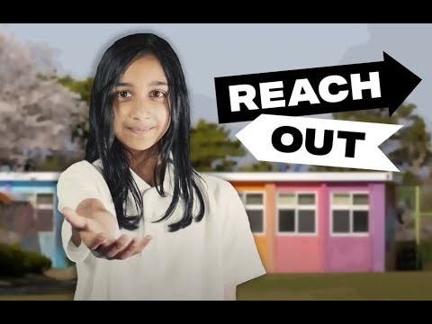

https://www.youtube.com/watch?v=aMfgZRdVbdw
Anti-Bullying Week 2022 – Reach out
4

Slide 5
Who might be involved in a bullying incident?
How many people?
What are they doing?
Anti-Bullying Week 2022 – Reach out
5

Slide 6


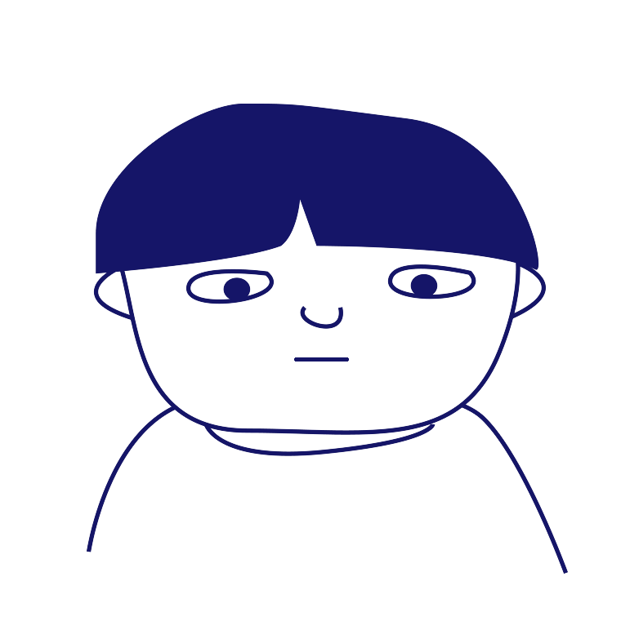

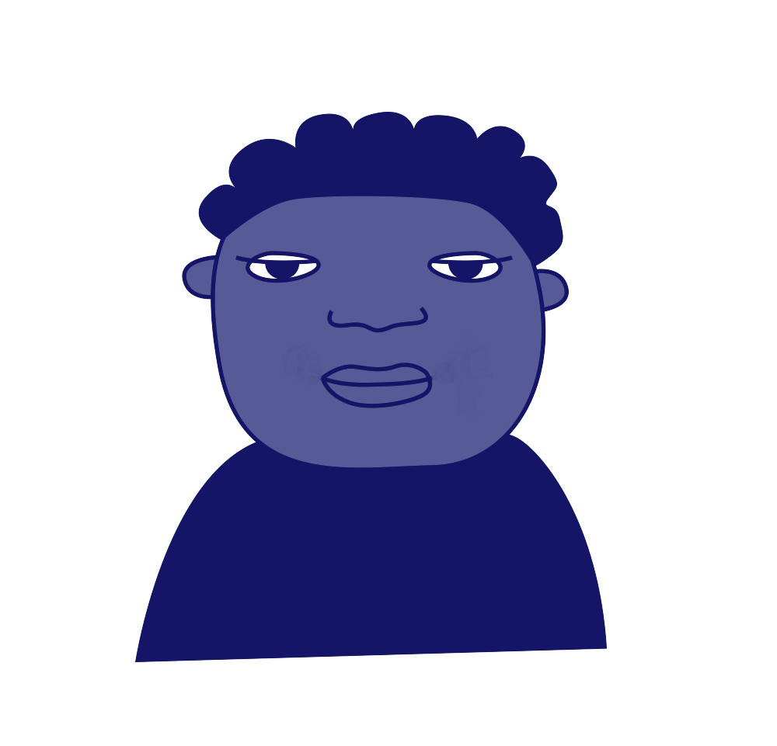
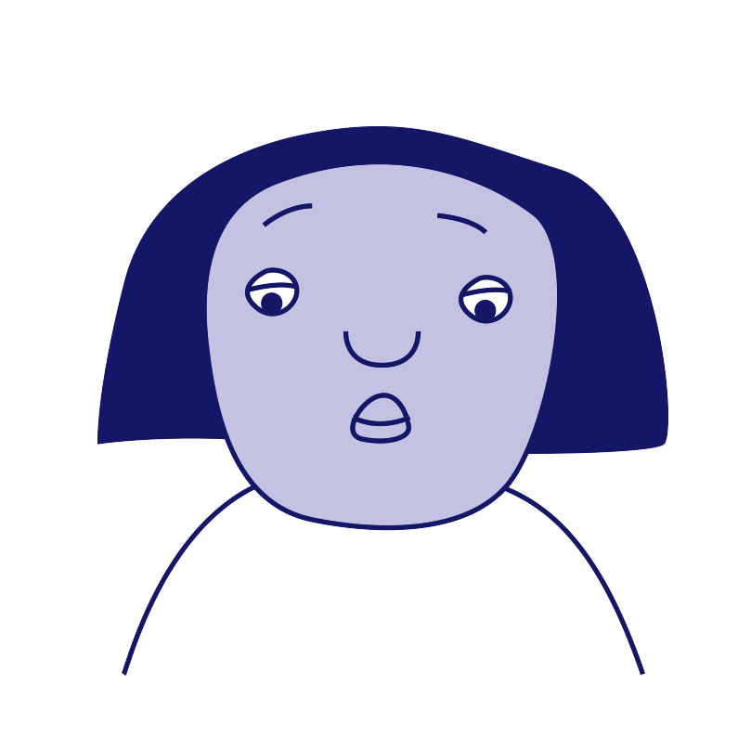
Roles involved in bullying
‘Ringleader’
‘Assistant’
‘Target’
‘Outsider’ or ‘Bystander’
‘Defender’
‘Reinforcer’
Anti-Bullying Week 2022 – Reach out
6
Notes:
Tell pupils that bullying rarely happens between two people without others being involved. Ask them who else might be involved. You could give them suggestions including: someone who sees it happening but says nothing, someone who tries to help, someone who gets involved in the bullying. Record their feedback on a board or flipchart.

Slide 7
Roles involved in bullying
‘Target’
There is the ‘target’ and this is the person the bullying is aimed at.
Anti-Bullying Week 2022 – Reach out
7
Notes:
Tell pupils that bullying rarely happens between two people without others being involved. Ask them who else might be involved. You could give them suggestions including: someone who sees it happening but says nothing, someone who tries to help, someone who gets involved in the bullying. Record their feedback on a board or flipchart.

Slide 8
Roles involved in bullying
‘Ringleader’
There is the ‘ringleader’, and this is the person who is initiating or leading the bullying. They might even be telling other people to join in.
Anti-Bullying Week 2022 – Reach out
8
Notes:
Tell pupils that bullying rarely happens between two people without others being involved. Ask them who else might be involved. You could give them suggestions including: someone who sees it happening but says nothing, someone who tries to help, someone who gets involved in the bullying. Record their feedback on a board or flipchart.

Slide 9
Roles involved in bullying
‘Assistant’
The ‘assistant’ is someone who is involved in ‘doing’ the bullying behaviour led by the ringleader, and might be actively doing the name calling or whatever the bullying might be.
Anti-Bullying Week 2022 – Reach out
9
Notes:
Tell pupils that bullying rarely happens between two people without others being involved. Ask them who else might be involved. You could give them suggestions including: someone who sees it happening but says nothing, someone who tries to help, someone who gets involved in the bullying. Record their feedback on a board or flipchart.

Slide 10
Roles involved in bullying
‘Reinforcer’
The ‘reinforcer’ is someone who doesn’t ‘do’ any bullying themselves but supports the bullying behaviour by standing by the ringleader and assistants, laughing along and encouraging the behaviour to continue.
Anti-Bullying Week 2022 – Reach out
10
Notes:
Tell pupils that bullying rarely happens between two people without others being involved. Ask them who else might be involved. You could give them suggestions including: someone who sees it happening but says nothing, someone who tries to help, someone who gets involved in the bullying. Record their feedback on a board or flipchart.

Slide 11
Roles involved in bullying
‘Defender’
There is also the ‘defender’, and that doesn’t always mean actively standing up to the ones doing the bullying – it could also mean telling a trusted adult what they have seen or even just asking the target if they are ok.
Anti-Bullying Week 2022 – Reach out
11
Notes:
Tell pupils that bullying rarely happens between two people without others being involved. Ask them who else might be involved. You could give them suggestions including: someone who sees it happening but says nothing, someone who tries to help, someone who gets involved in the bullying. Record their feedback on a board or flipchart.

Slide 12
Roles involved in bullying
‘Outsider’
You also have the ‘outsider’ or ‘bystander’ role. This is someone who is either unaware of the bullying happening, or is choosing to ignore it and not involve themselves at all.
Anti-Bullying Week 2022 – Reach out
12
Notes:
Tell pupils that bullying rarely happens between two people without others being involved. Ask them who else might be involved. You could give them suggestions including: someone who sees it happening but says nothing, someone who tries to help, someone who gets involved in the bullying. Record their feedback on a board or flipchart.

Slide 13
How can our school community help students reach out?
Group Discussion
Anti-Bullying Week 2022 – Reach out
13
Notes:
Sharing a smile Asking ‘are you OK?’ Inviting someone to join in a game at break time, especially if you notice they have no one to play with Offering to help someone in a maths lesson if you notice they are finding something difficult Pass on a compliment - tell someone something you like about them

Slide 14
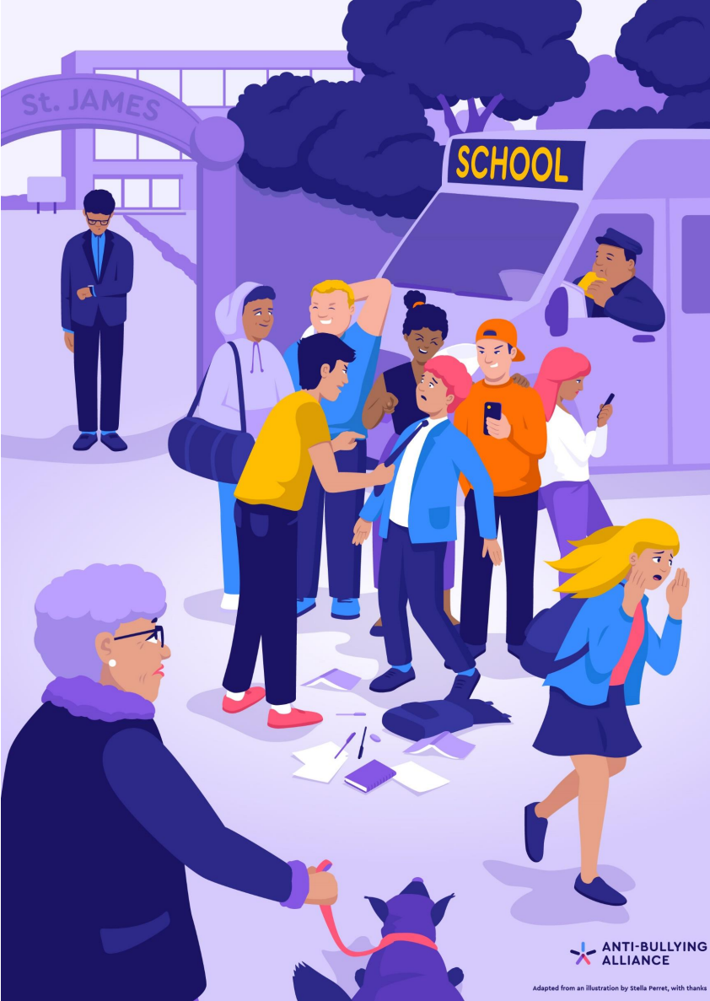
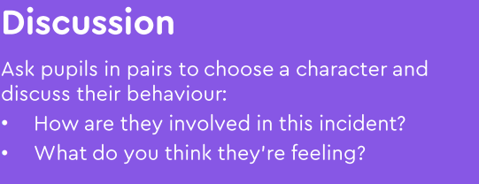

Slide 15
Scenario
1
Every time Rhys goes onto the field at break time, a group of girls follow him around and are unkind to him. Two of them shout names and make fun of his hair, and the rest of them watch and laugh along.
Which roles can you see in this scenario? How could each person reach out?
Anti-Bullying Week 2022 – Reach out
15

Slide 16
Scenario
2
Whenever Janai joins an online game on her PlayStation with her classmates, Dylan always tells other children to leave the game and start a new one without her.
Which roles can you see in this scenario? How could each person reach out?
Anti-Bullying Week 2022 – Reach out
16

Slide 17
Scenario
3
Vanisha has noticed that every time her class line up for lunch, there are some children who are pushing Erin around.
Which roles can you see in this scenario? How could each person reach out?
Anti-Bullying Week 2022 – Reach out
17

Slide 18
Scenario
4
Jac is often told by Sofia to spread unkind rumours about Amelia by whispering and passing notes around.
Which roles can you see in this scenario? How could each person reach out?
Anti-Bullying Week 2022 – Reach out
18

Slide 19
Thank you for being a part of
ANTI-BULLYING
WEEK 2022

